Slide 1

Intro to 3D Jewelry Design & 3D Modeling

Slide 2
Today’s Agenda
SECTION 1: Overview of 3D Technology in Fashion
SECTION 2: 3D Modeling Hands-On Demo
SECTION 3: Online Printing Services
SECTION 4: Free Modeling Time
SECTION 5: Take Home Projects

Slide 3
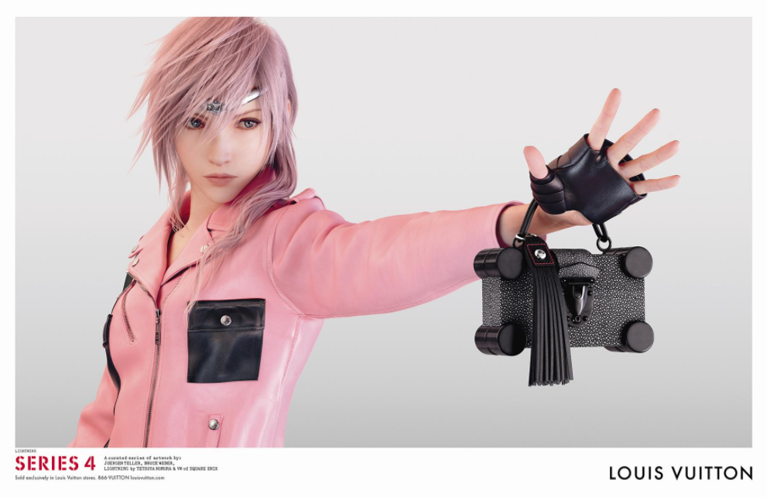
SECTION 1
3D Technology in Fashion
Notes:
Below is a script, but feel free to paraphrase or say in your own words:
“This is an advertisement from the fashion brand, Louis Vuitton, who makes high-end handbags and accessories. This is just one image from their Series 4 ad campaign which uses 3D technology to create everything you see in this image, including the “human” model, her clothing and her accessories. This is an example of how the fashion industry is beginning to use 3D to engage with their customers.”

Slide 4
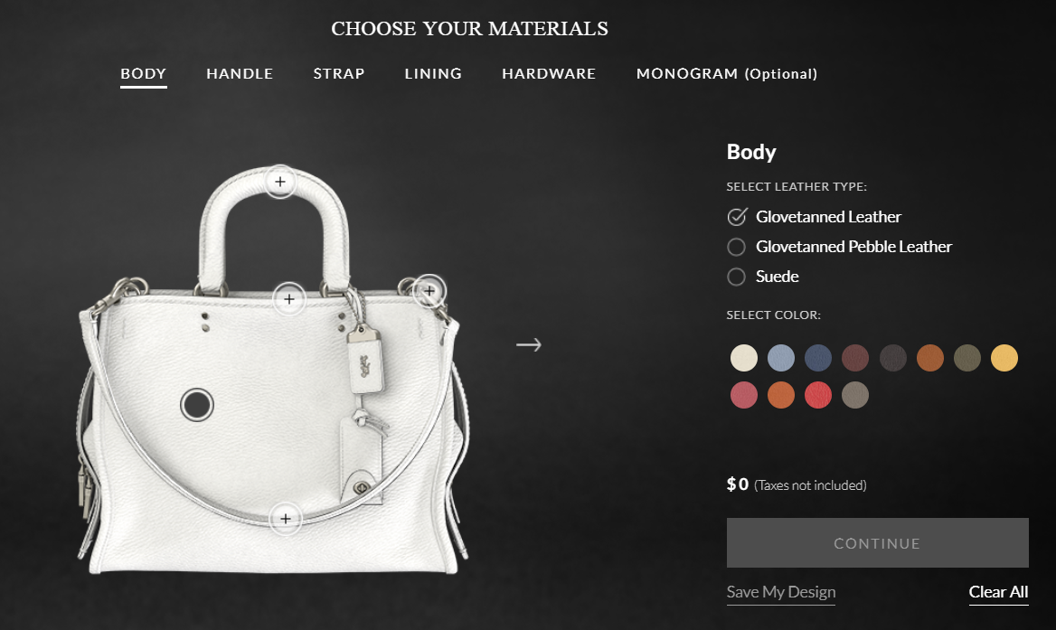
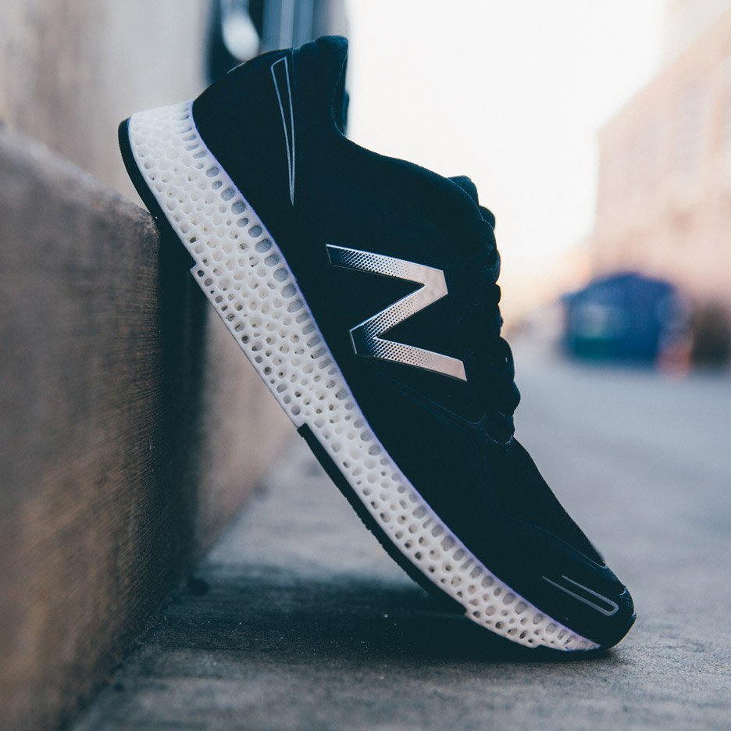
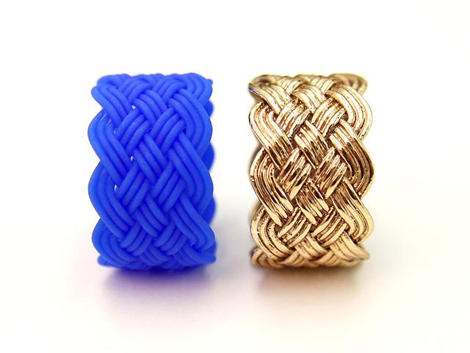
Fashion & Related Industries
3D technology is used for prototyping of new designs, customer engagement and in the manufacturing of custom fit items.
Fashion
COACH, Prototyping & Customer Engagement
Athletics
NEW BALANCE, 3D Printed Sole
Jewelry
Used in Lost-Wax Casting
Notes:
Below is a script, but feel free to paraphrase or say in your own words:
“3D Technology is used fashion and related industries like athletics and jewelry. In these examples you can see how Coach has created a 3D model of a handbag where customers can go online and create their own customized design. New Balance is using 3D printing in production to create 3D printed shoe soles which can be customized for the perfect fit and performance. The jewelry industry adopted 3D technology early on and use it to replace a very time consuming part of the design process.”
(Explained in greater detail on next slide.)

Slide 5
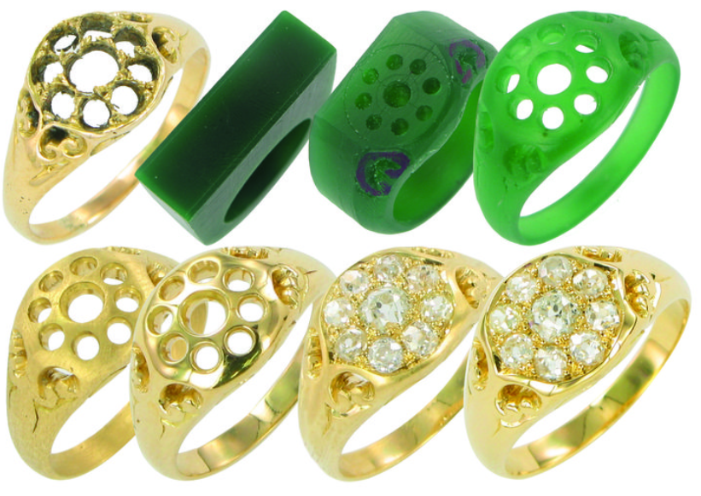
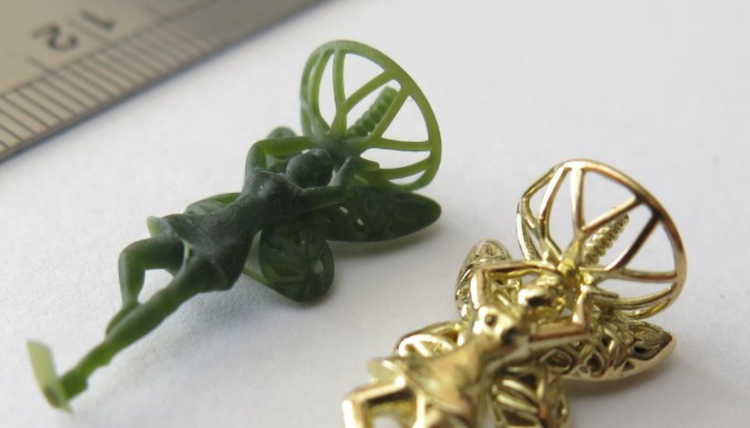
Lost Wax Casting
3D printing castable wax models replace the traditional method of hand carving models.
3D printing allows us to create wax models quickly.
The wax model undergoes the same casting process.
Original method required wax to be carved by hand
and then melted away to create a mold for metal casting.
Notes:
Below is a script, but feel free to paraphrase or say in your own words:
“Prior to the use of 3D printing, jewelers carved wax models by hand. The wax models were then used to create molds to cast metal parts from. 3D printing has allowed jewelers to 3D print those wax models, replacing the time consuming hand carving process. By 3D modeling and printing a wax model instead of hand carving it, you can achieve more consistent designs and can make changes to the designs easily.
After we complete the lesson on modeling a bangle, I will show you how to utilize online 3D printing services which utilize this common jewelry manufacturing process to create your own jewelry in the same way that professional jewelry designers do.”

Slide 6
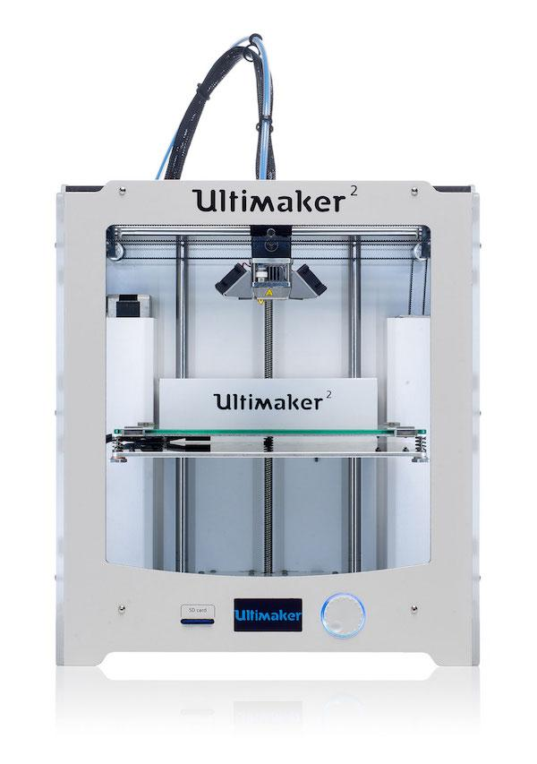
Common Types of 3D Printers
FDM – Fused Deposition Modeling
Lays down material, layer by layer from a single filament
Original “desktop 3D printer” method.
Fast printing, low resolution & detail, inexpensive.
Notes:
Below is a script, but feel free to paraphrase or say in your own words:
“You may be familiar with this desktop 3D printer. There are hundreds of 3D printer models which are relatively inexpensive and you may have seen 3D printers like this in your school’s makerspace. This is a very common type of 3D printer technology, knows as “FDM”. FDM printers are similar to a glue gun in that there is a single strand of plastic on a spool which is fed into the printer nozzle which is heated up and extruded while the print nozzle moves around the print tray, creating a 3-dimensional part.”

Slide 7
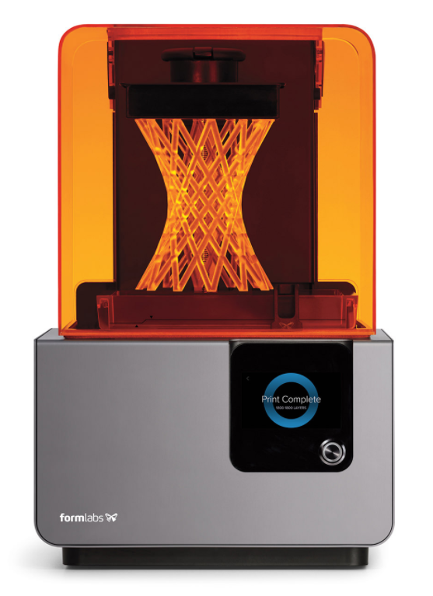
Common Types of 3D Printers
SLA - Stereolithography
Uses UV light to harden liquid plastics, layer by layer.
Original 3D technology, invented in 1980’s.
Slower printing, highest resolution & detail, traditionally expensive.
Notes:
Below is a script, but feel free to paraphrase or say in your own words:
“While FDM 3D printers have only been around for a little over a decade, SLA printers have been around much longer. SLA was invented in 1986 and originally was used commercially for manufacturing. SLA 3D printing can be compared to 2D printing in that thin layers of plastic are stacked on top of each other, slowly building a 3D part. SLA printing creates the highest quality 3D models.”

Slide 8
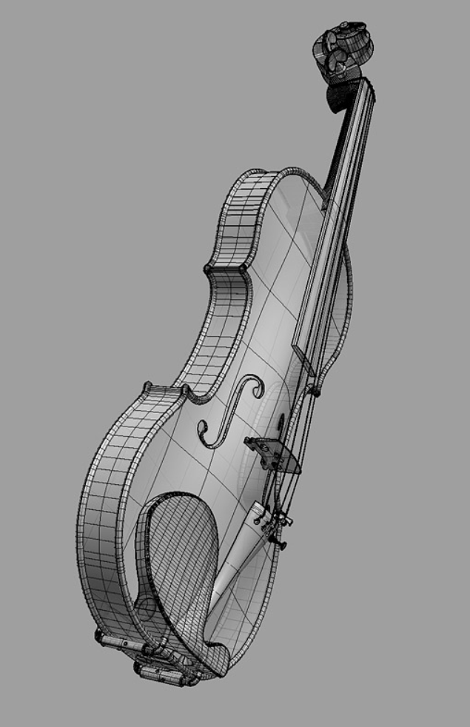
Common Types of 3D Software
Surface Modeling
Rhinoceros 3D, Alias
Used in architecture, jewelry, aviation, automotive, industrial design.
Create and “stitch” surfaces together to create solid parts.
Notes:
Below is a script, but feel free to paraphrase or say in your own words:
“Before we can 3D print a part, we have to create a 3D model. This is what we will learn to do today!
There are three common types of 3D modeling softwares. Each of three types of software have different types of designs that they are best suited for. If you decide you want to pursue your learning in 3D modeling, you should decide which type of modeling software to learn based on what type of designs you want to make.
Our first modeling software is SURFACE modeling. Surface modeling uses surfaces which are digitally stitched together to create solid shapes with volume. Some examples of 3D surface modeling software is Rhino 3D and Alias.”

Slide 9
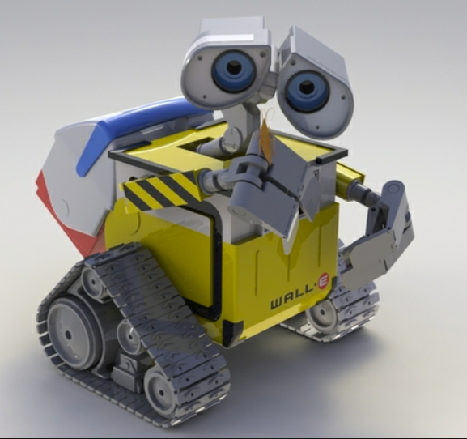
Common Types of 3D Software
Solid Modeling
Tinkercad, Fusion360, Solidworks
Used in engineering, aerospace, machinery.
Trims and combines solids together to create complex parts.
Notes:
Below is a script, but feel free to paraphrase or say in your own words:
“The next type of modeling software is SOLID modeling. Solid modeling uses solid shapes which are combined to create complex solid models. Tinkercad, which we will be using today is an example of a solid modeling software. Other examples are Fusion 360 and Solidworks.”

Slide 10
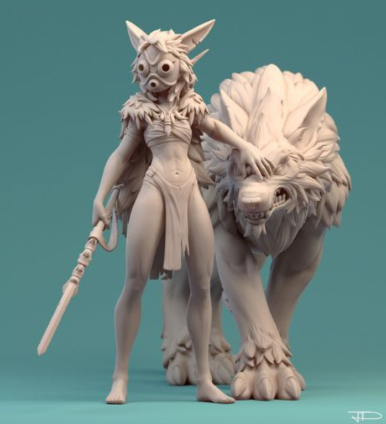
Common Types of 3D Software
Sub-D/Mesh Modeling & Sculpting
Sculptris, Modo, Maya
Used in film/TV, simulations, medical, industrial design.
Modeling with polygon mesh solids which are highly editable and deformable. Able to create organic shapes easily.
Notes:
Below is a script, but feel free to paraphrase or say in your own words:
“The last type of modeling software is subdivision, or Sub-D mesh modeling and sculpting. If you play video games or watch a lot of movies, you have seen a lot of examples of mesh modeling. These types of modeling softwares are used to create special effects and characters which you might know as “CGI”. Sculptris is a great FREE software to check out if you are interested in character modeling and sculpting.”

Slide 11
SECTION 2
Hands On Demo-
3D Model a Pendant
Notes:
NOTE: Have the students get their laptops set up and log into Tinkercad.com. Have the TA’s hand out the printed packets of Section 2, 3 & 4. At this point, you’ll want to demo on screen and will need to close this presentation to do that so please make sure you have a copy as well.

Slide 12
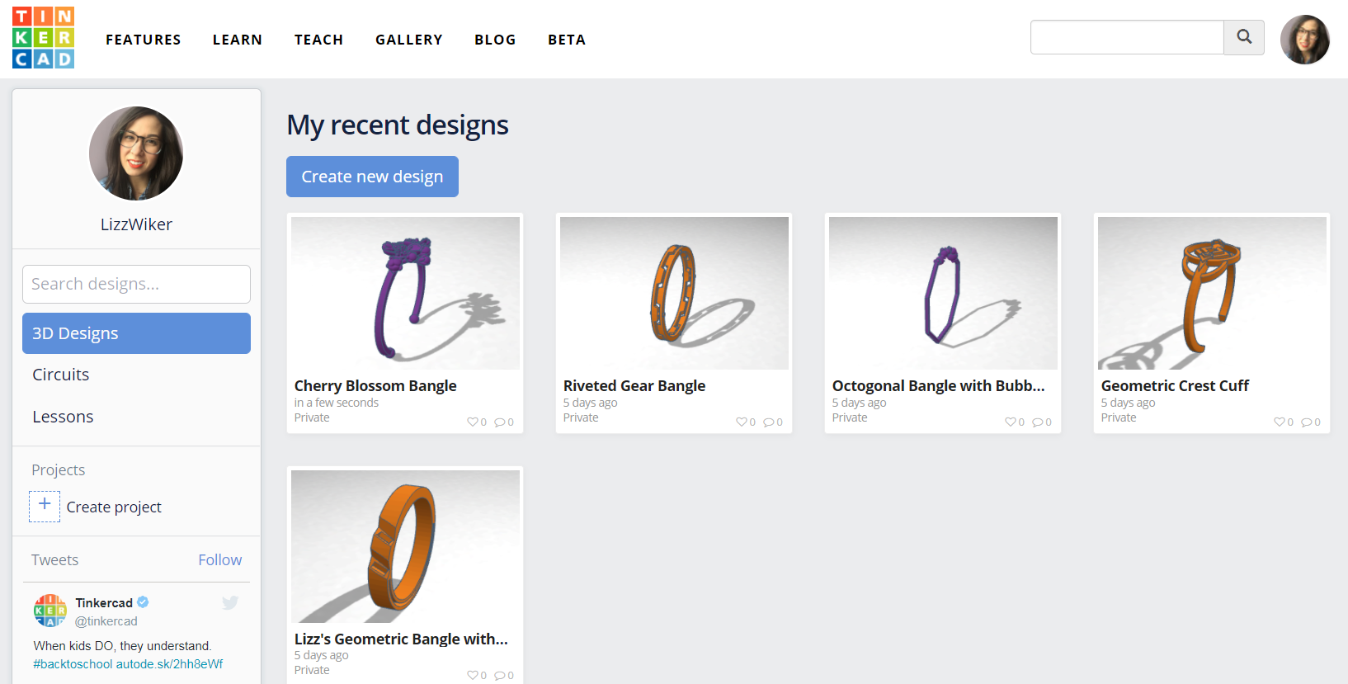
Opening Tinkercad
Open Tinkercad at www.tinkercad.com and log in.

Slide 13
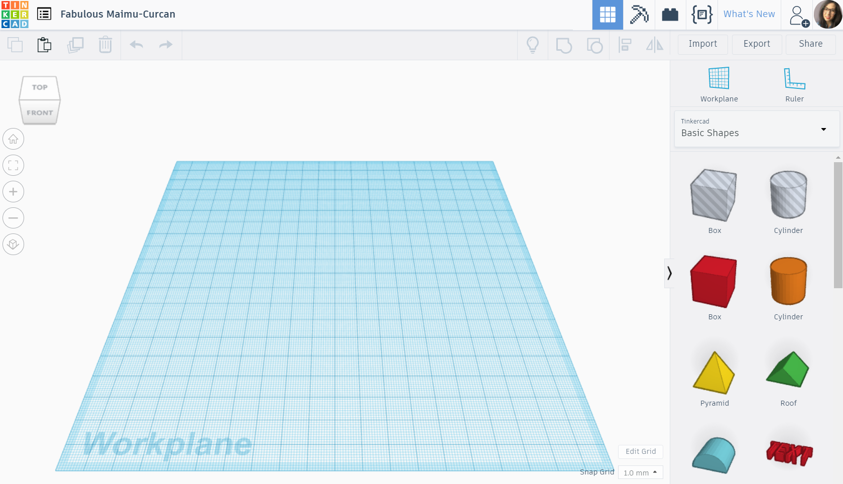
Tinkercad’s Interface
Return to project menu
Name your project
Until you get used to the mouse
controls, use the cube to move around.
Shapes menu
Orientation cube
Home view
Fit view to selection
Zoom In
Zoom Out
Orthographic View
Grid settings
Default “ground” workplane
Grid snap increments

Slide 14
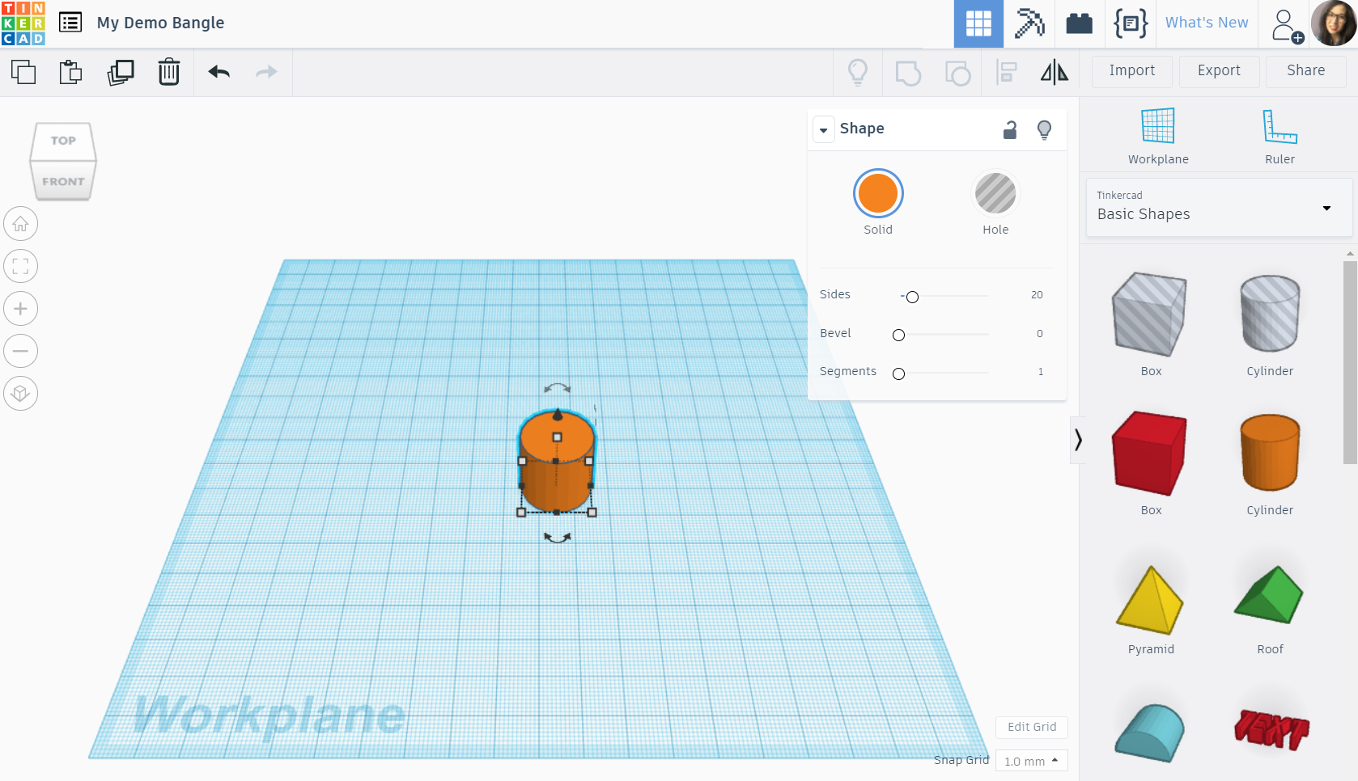
Manipulating Shapes
TRY IT OUT!
Drag a cylinder to the center of the workplane.
Try zooming in/out.
Use the right-mouse button to rotate around the object.
Hold ‘shift’ and use the right-mouse button to pan the view back and forth.
Click the object to select it.
Use the manipulation arrows and points to move, scale and rotate the object.
Try changing the object to be a hole.
Change the object back to a solid and change the color.

Slide 15
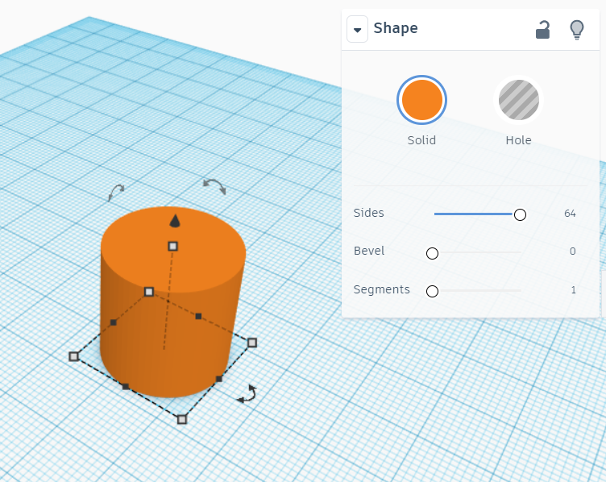
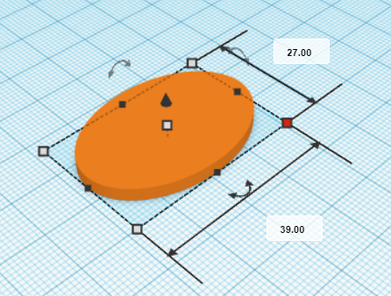
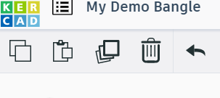
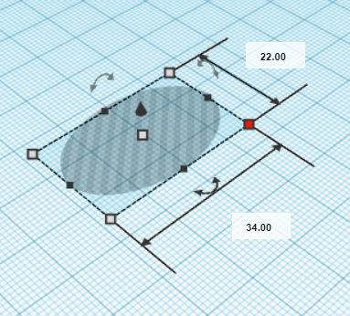
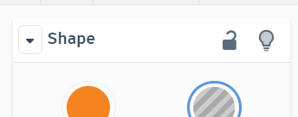
Modeling a Pendant
Creating the pendant base
1. Add a SOLID CYLINDER to the workplane
Set # of sides to 64
2. Resize the cylinder to be 27 width x 39mm length with 3mm thickness.
3. DUPLICATE the pendant body and HIDE one of them.
4. Change the visible pendant body to be a HOLE and resize it to be 22 width x 34mm length with 1mm thickness.
1
2
3
4

Slide 16
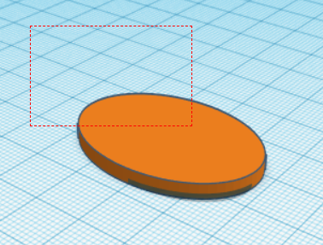
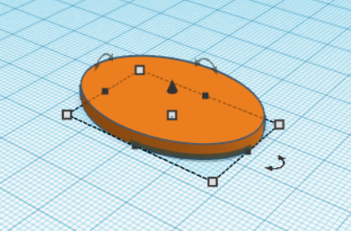

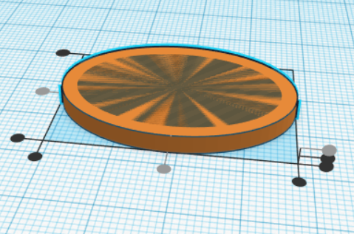
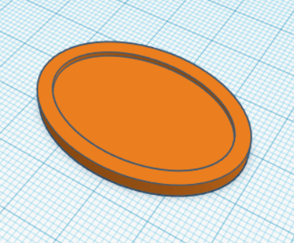

Modeling a Pendant
Finishing the pendant body
1. Click the SHOW ALL button to unhide the hidden pendant body.
2. Use a BOUNDING BOX to select both cylinders.
3. ALIGN the cylinders with each
other at their center points and
at the top surface.
4. GROUP the cylinders to “trim”
the hole cylinder from the solid
cylinder.
2
1
3
4

Slide 17
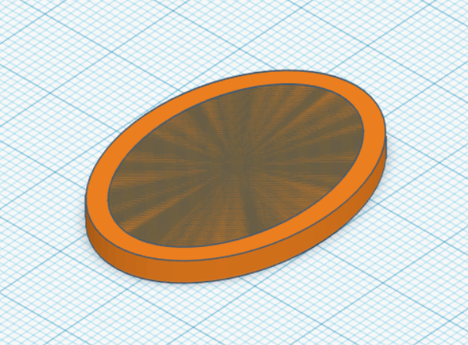
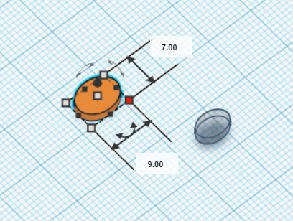

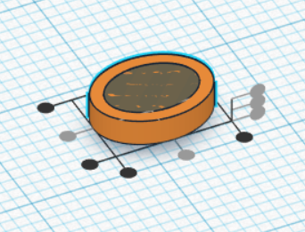
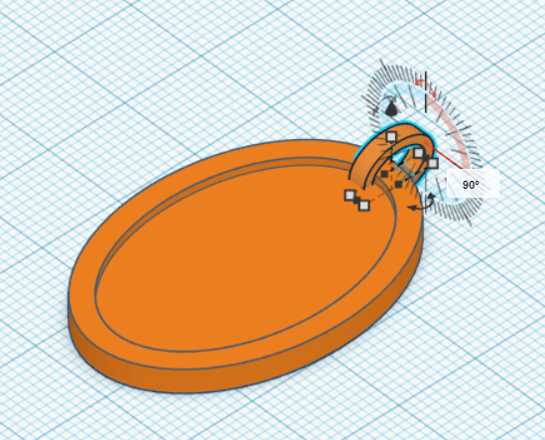
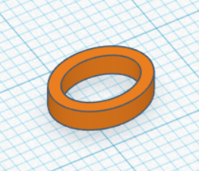

Modeling a Pendant
Adding a top loop to the pendant body
DUPLICATE the pendant body and
then HIDE one of the copies. UNGROUP
the visible pendant body.
2. Separate the two cylinders and resize them to the following measurements:
Outer (solid)- 7mm W x 9mm L, 2mm thickness.
Inner (hole)- 5mm W x 7mm L, 2mm thickness.
3. ALIGN the cylinders at all center points and GROUP them together.
4. Use SHOW ALL to make the cylinder
body visible again. Then rotate the top
loop by 90 degrees.
1
2
3
4

Slide 18
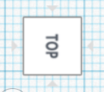
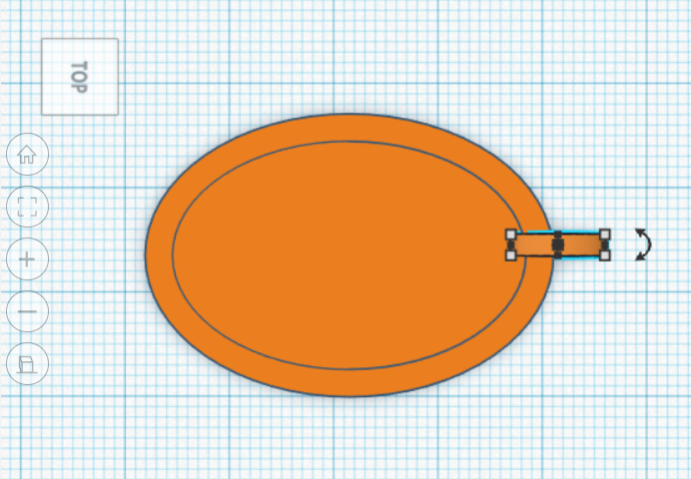
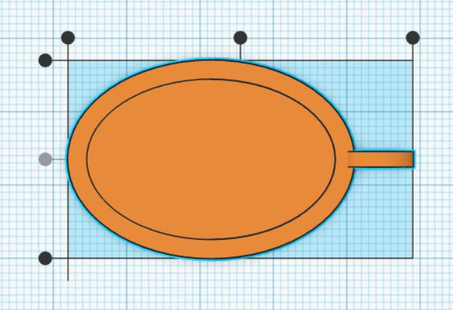

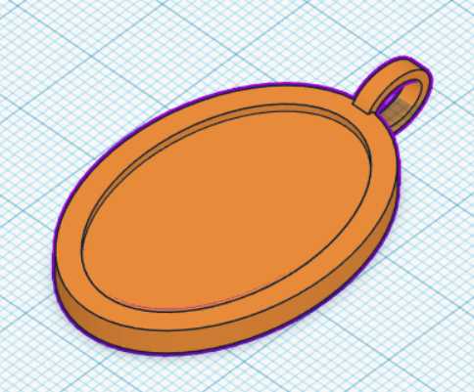
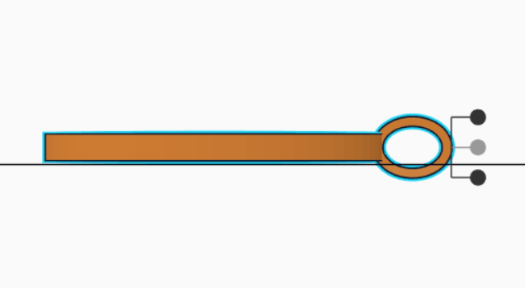

Modeling a Pendant
5. To position the top loop, use the
ORIENTATION CUBE to navigate to the
top view.
6. Drag the top loop to the position you want it.
Then ALIGN the center points.
7. Navigate to the right view on the ORIENTATION CUBE and ALIGN the
center points.
8. GROUP the top loop with the pendant
base. Then LOCK the finished pendant
base.
5
6
8
7

Slide 19
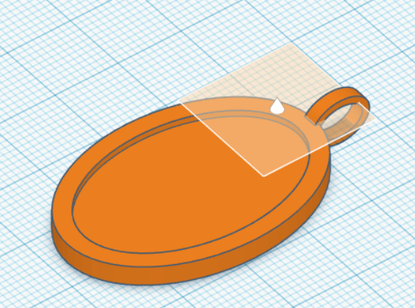
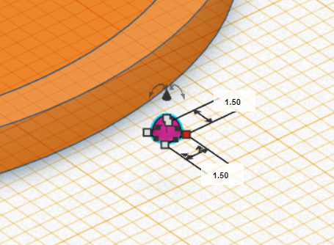

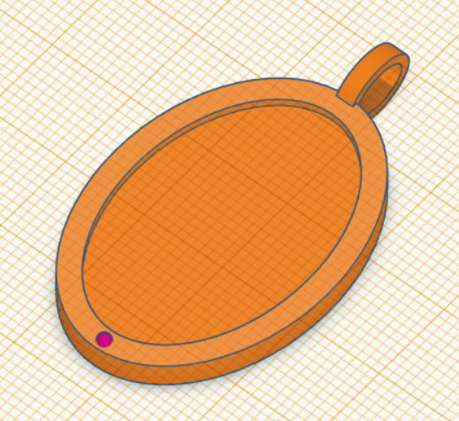
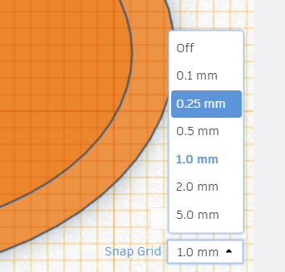
Modeling a Pendant
Adding design details to the pendant
1. Create a new WORKPLANE on the
surface of the raised pendant rim.
2. Add a HALF SPHERE to the workplane and resize it to be 1.5mm diameter with 1mm height.
3. Position the half sphere on the bottom center of the raised pendant rim.
4. Adjust the SNAP GRID distance to 0.25mm to more easily position the half sphere on the rim.
1
2
3
4

Slide 20
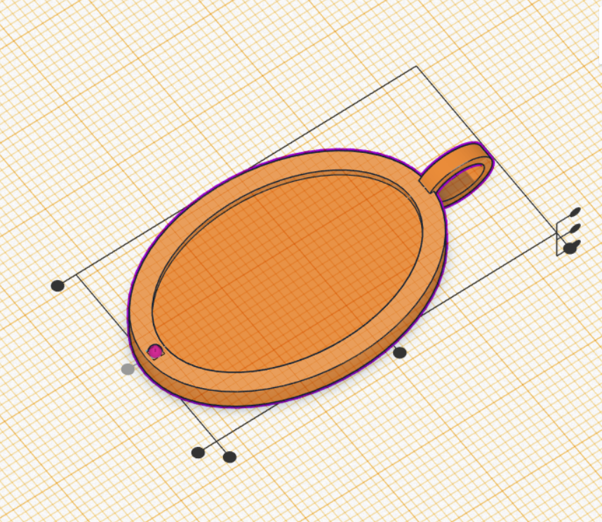
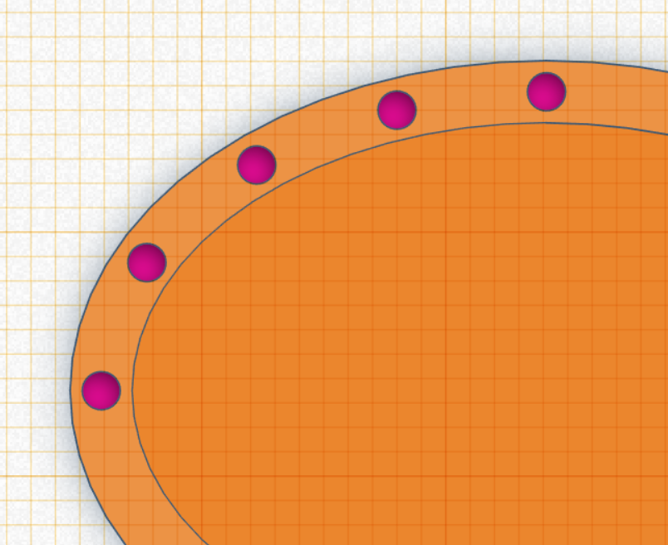
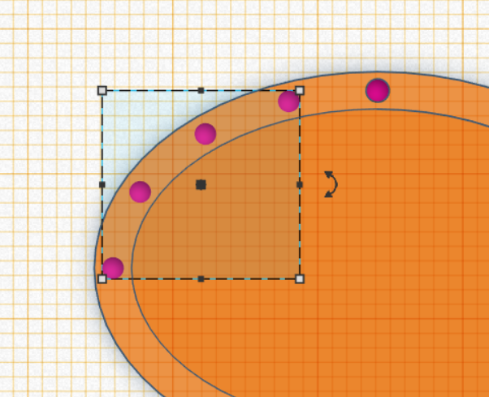
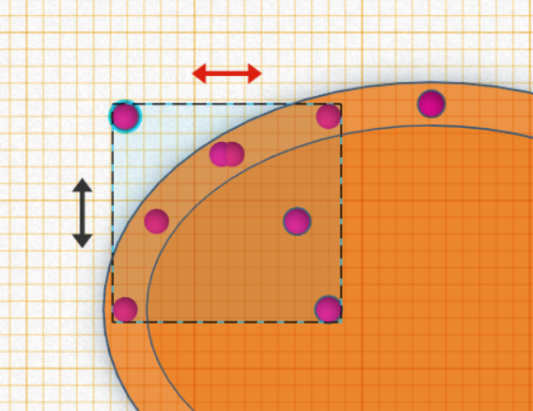

Modeling a Pendant
5. ALIGN the centers of the pendant base and the half sphere.
6. DUPLICATE the half sphere and move it to the 9 o’clock position of the rim.
Then DUPLICATE the half sphere and manually move them to add 3 more evenly spaced out half spheres in between the first 2.
7. Select and then GROUP 4 half spheres.
8. DUPLICATE the 4 grouped half spheres and then MIRROR them.
5
6
7
8

Slide 21
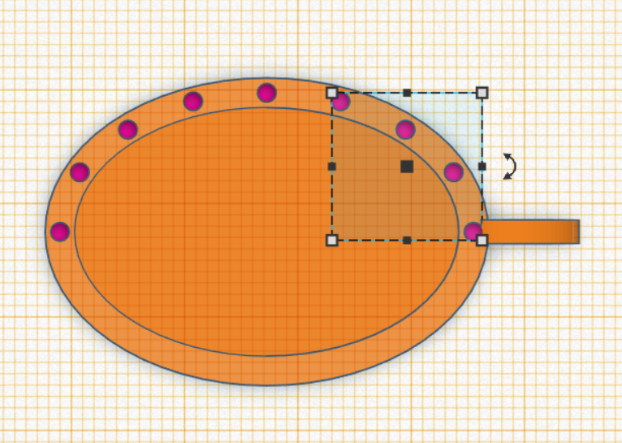
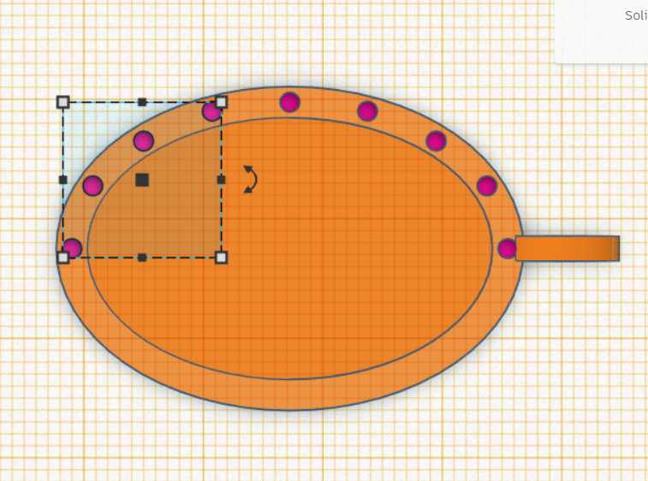
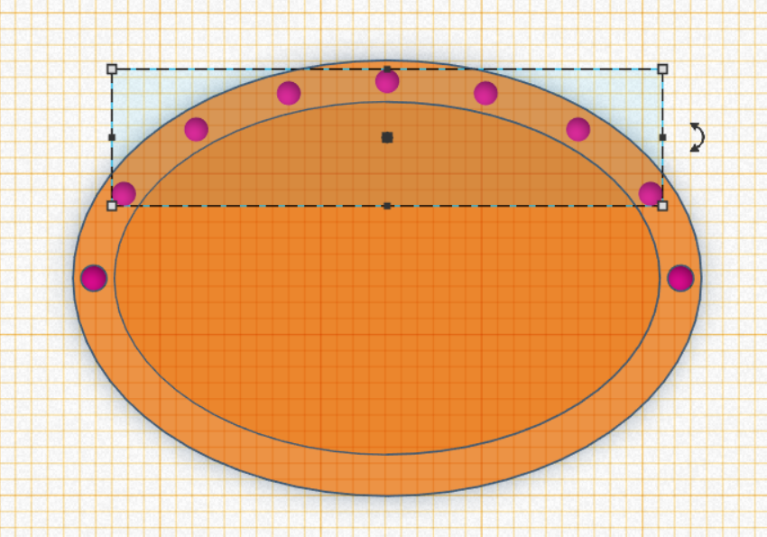
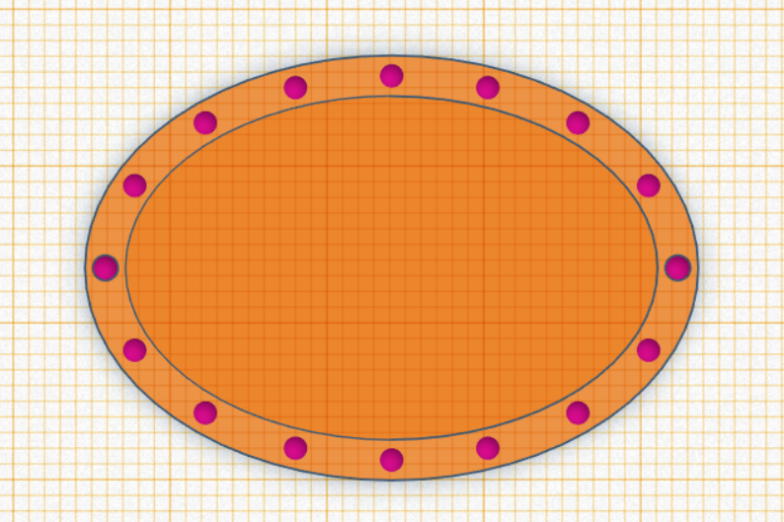
Modeling a Pendant
9. Move the flipped 4 half spheres to the opposite side of the rim.
10. Select both groups of half spheres and UNGROUP them. Then select the top 7 spheres and GROUP them.
11. On your own, repeat the above process to add half spheres to the other side of the raised pendant rim.
(HINT: Duplicate, group, flip and move to achieve this.)
9
10
11

Slide 22
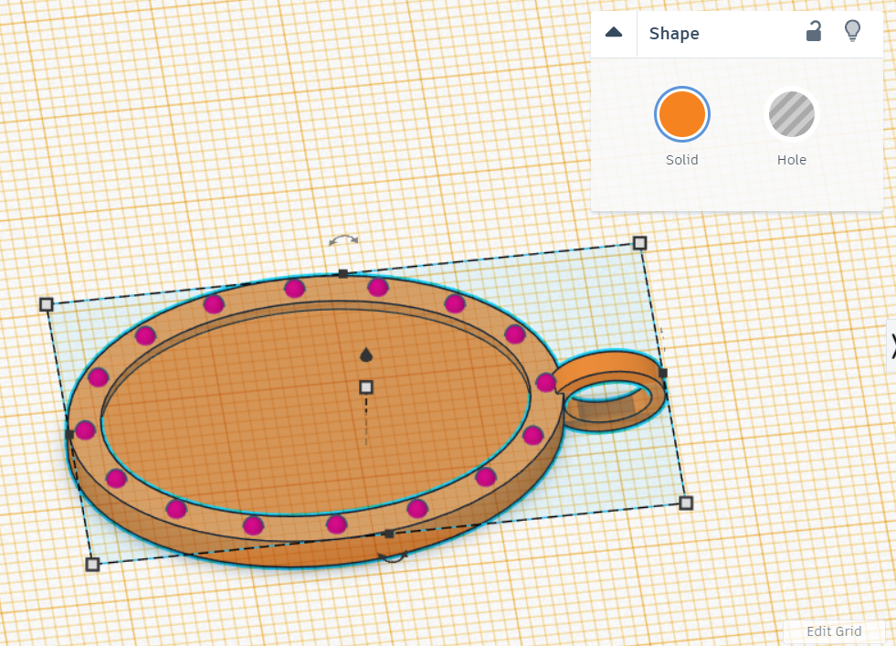
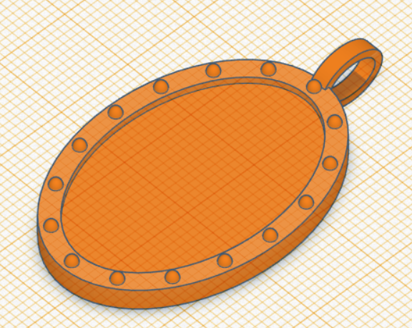
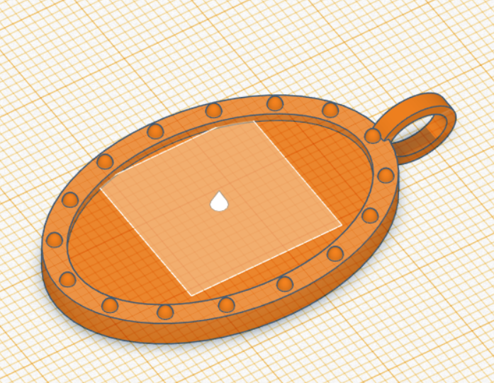
Modeling a Pendant
Finishing the pendant body
1. UNLOCK the pendant body and top loop.
2. Select all items and GROUP to finish your pendant base.
3. Set your WORKPLANE to the sunken center surface of your pendant base.
1
2
3

Slide 23
SECTION 3
Online 3D Printing Services

Slide 24
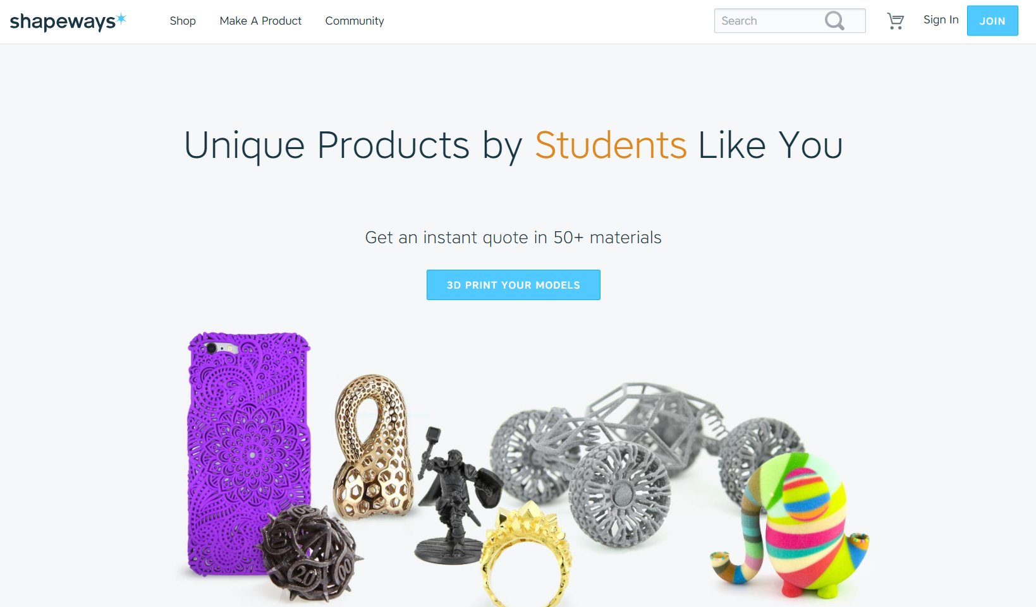
Online 3D Printing Services
There are several online 3D printing services you can use to manufacture your designs.
If you order from Shapeways, use discount code GDDQZ for 15% off your first order!
www.shapeways.com

Slide 25
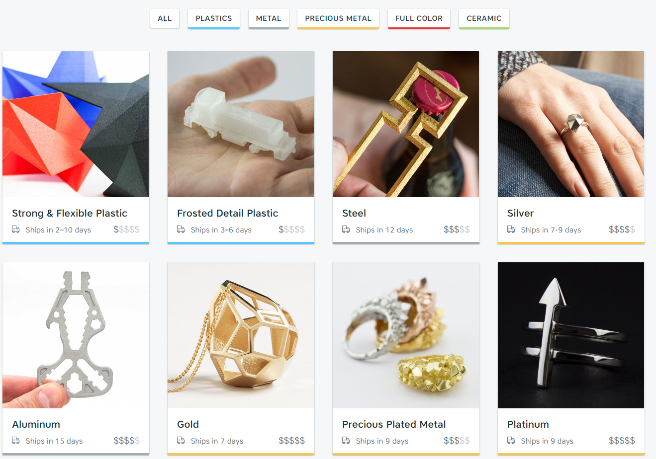
Online 3D Printing Materials
3D printing can be done in various plastics, metals and ceramic!

Slide 26




Using Online 3D Printing Services
1
2
Uploading a 3D model file
Make sure you exported your design from
Tinkercad as an .stl file.
Upload your .stl file into Shapeways (or other online 3D printing service.)
Select the material you are wanting to print your design in and see if the model passed the required model checks before placing your order.
DISCOUNT!!! If you order your model through Shapeways.com, use discount code GDDQZ for 15% off your first order!
3

Slide 27









Using Online 3D Printing Services
Be sure follow the design guidelines for the material you are printing your design in!

Slide 28
SECTION 4
Free Modeling Time -
Add personal details to your pendant!

Slide 29



DESIGN IDEAS
Add your initials to the center-
1. Use TEXT to generate initials.
2. Adjust the height.
3. ALIGN with the pendant base
and GROUP.
Add a sketched design -
1. Use SCRIBBLE to generate sketch.
2. Adjust the height.
3. Scale and position your sketch
and GROUP.
Use various shapes to create cut
outs -
NOTE: Consider grouping symmetrical
shapes together to easily align and
center them on the pendant.

Slide 30
Share your work with
another student!

Slide 31
SECTION 5
Take Home Projects-
Model a Bangle!

Slide 32

Tips for designing your bangle!
#1: Use the 3D printed bangle sizers to check your size.
X-Small
62x50.5mm
Small
66x55mm
Medium
70x57mm
Large
74x61mm
X-Large
78x65mm
My Bangle Size ___________________________________

Slide 33



Tips for designing your bangle!
#2- Check out the other shape menu’s in Tinkercad.

Slide 34



Tips for designing your bangle!
#3- Want to continue learning? Check out the following lesson and quick guides.
Lesson: Bubbles Bangle
Lesson: Geometric Crest Cuff
Quick Guide: Cherry Blossoms
Difficulty: Beginner
Difficulty: Intermediate
Difficulty: Advanced

Slide 35




Lesson: Bubbles Bangle
Create a POLYGON shape with 8 sides. Rotate the the shape 22.5 degrees so the top and bottom have flat faces. Make this a hole.
Duplicate the shape and make it larger to create the body. Group them together to make the bangle body.
Add SPHERES to the bangle body.
Group everything together to complete the bubbles bangle!
1
2
3
4

Slide 36




Lesson: Geometric Crest Cuff
Create the bangle body in your desired size. (NOTE: If the bangle is not continuous, you can have a tighter fitting bangle.)
Create the oval base for the crest design.
Duplicate the oval base and use one of them to cut the band.
Leave the remaining oval shape as the base for the crest.
Duplicate the oval shape and change the dimensions so its smaller in both the length and width.
1
2
3
4

Slide 37




Lesson: Geometric Crest Cuff
6
7
6. Use a box to remove a section in the
oval base. Make the resulting semi-
circles into holes.
Group the semi-circles with the cuff body to create the cut outs in the crest.
8. Add stacked roof details to the center
bar.
Create 2 tube shapes to create the outer arcs of the crest. (HINT: Tubes are in the “basic shapes” menu.)
8
9

Slide 38




Lesson: Geometric Crest Cuff
10
Use the original cylinder you created for the hole in the main bangle body to trim away the bottom of the tubes.
Create a cylinder on top to cut away from the top of the two tubes, creating the curved shape of the bangle.
11

Slide 39



Lesson: Geometric Crest Cuff
12
13
12. Add some additional roof shapes onto
both sides of the bangle and group
everything into one.
13. Add a box hole into the center to trim
it away.

Slide 40


Quick Guide: Cherry Blossoms

